Slide 1

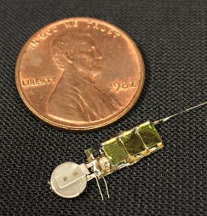
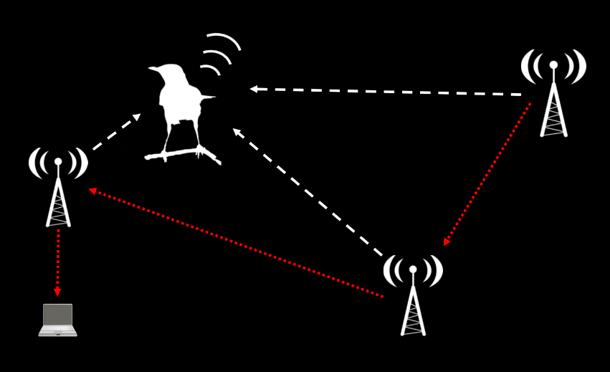
AMRUPT (Animal Movement Research Using Phase-based Trilateration)

Slide 2
AMRUPT (Animal Movement Research Using Phase-based Trilateration)
By the third week of the semester you will submit a project proposal (details provided in syllabus) covering the current phase of the AMRUPT project.
Failure to submit 3 or more weekly updates will result in the student being dismissed from the project. Updates may not be submitted late.

Slide 3
Proposal: literature review section
Define the AMRUPT Problem
Project Proposal
Khandani, 2005

Slide 4
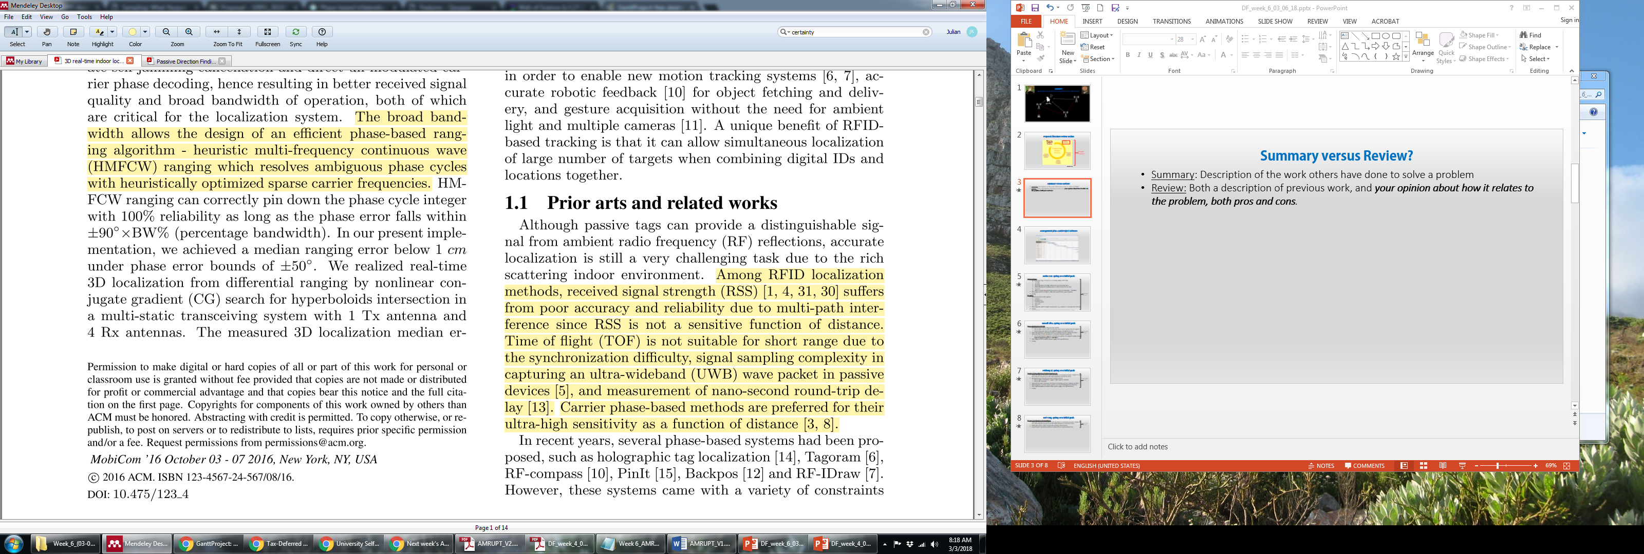
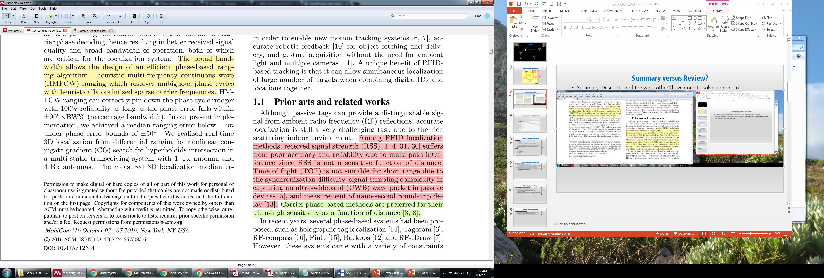
Literature Review: what's the purpose?
Cons of approaches of references 1, 4, 5, 13, 30, 31
Pros of approaches of references 3, 8

Slide 5
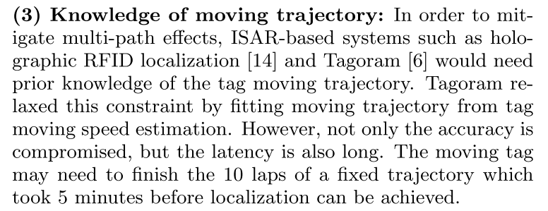
Literature Review: how's it organized?
What to focus on??
Topics relevant to goals!
Constraints to be overcome and
approaches that hold promise
The studies provide the examples of identified constraints or promising approaches

Slide 6
Literature Review: how's it organized?
From the proposal
Řeřucha et al. [12 ] developed an architecture to use location tracking for ecological field studies. This architecture presents a network of automated trackers and software to facilitate tracker operation.
Smith, Balakrishnan et al. [15] developed a chip which uses a combination of RF and ultrasound technologies to provide location information to attached host devices. When this pulse arrives, the listener obtains a distance estimate for the corresponding beacon by taking advantage of the difference in propagation speeds between RF (speed of light) and ultrasound (speed of sound).

Slide 7
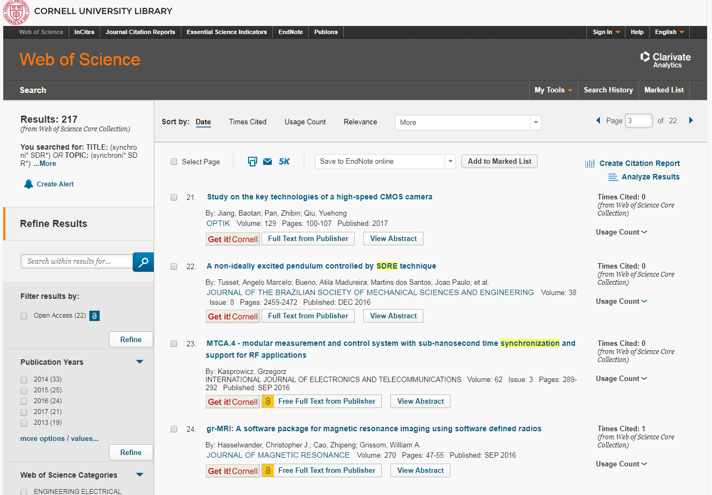
Literature Review: where to find resources?
Other papers
Web of Science
Don’t depend on GitHub!

Slide 8
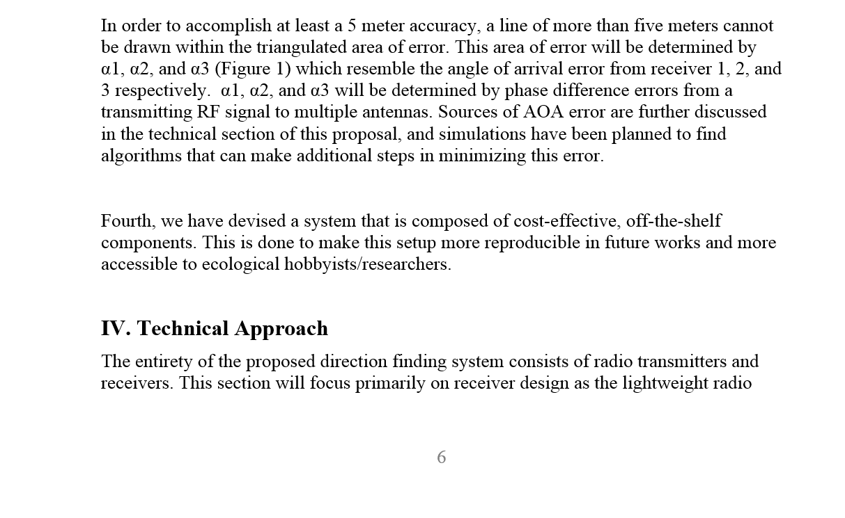
Design objectives: forward-compatibility
What are the basic requirements for being forward compatible??

Slide 9
Technical Approach
What are the proposed solutions to achieve the previously outlined objectives for this project?
Refer (explicitly) to workable solutions from others’ previous work, technical analysis, simulations, or indicate how you will evaluate solutions
Explain design tradeoffs, constraints, and back up your claims with citations
How will you analyze the performance of your solution? How will that analysis inform design choices?
Explicitly detail which tests you will perform to inform which decisions
Explain what the test result values would mean? I.e. How will these values influence the design process??

Slide 10
Technical Approach:
Receiver architecture
Synchronization technique | Pros | Cons | Error | Refs
Time-modulated array | Single radio (no synchronization needed) No complicated positioning algorithm Low cost | Poor accuracy (?) More susceptible to noise | 10%, 0.8% | Baik et al (2017), Ma et al (2016)?
Mixer-demodulator-ADC, driven by common LO | High accuracy Low susceptibility to noise | Multiple mixers/demodulators to be coupled with LO May be expensive / complex | 0.415 degrees | Guerin et al (2012)
Beacon synchronized | Cheap Can use SDRs | Low accuracy Multiple radios Beacon position and radiation pattern must be controlled | 15% | Chen et al (2012)
Internal signal synchronization | Cheap Can use SDRs | Accuracy low (?) | 1 sampling period | Bartolucci et al (2016)
Synchronization technique
Time-modulated array

Slide 11
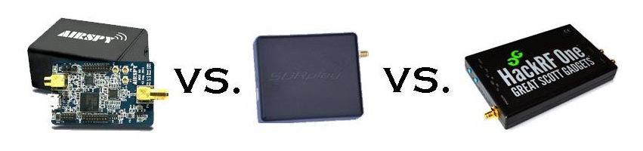
Technical Approach:
Receiver architecture
Will the CC1310 be sufficient for any of these approaches?
What about SDRs?

Slide 12
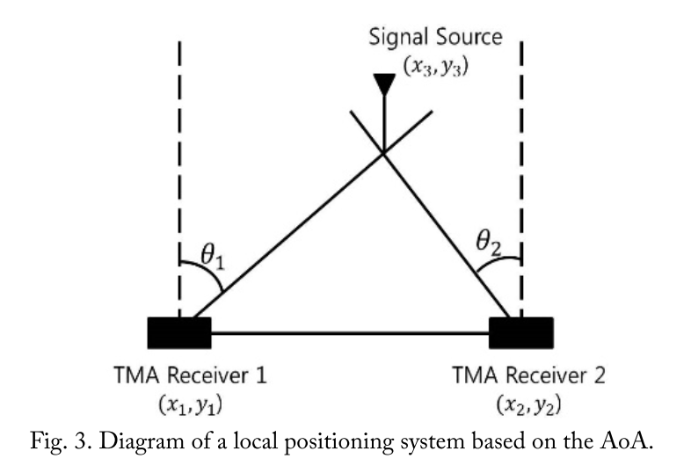
Technical Approach:
Ambiguity
Phase disambiguation section of proposal excellent example of technical analysis based on previous work
Are distance and quadrant ambiguity actually concerns?
Use the same kind of analysis (in depth reading about existing systems) to justify other important design choices:
Antenna geometry
RF switching methodology (pros, cons, alternatives)
Undersampling and effects on DF
Beacon-based versus equalization-based channel synchronization

Slide 13
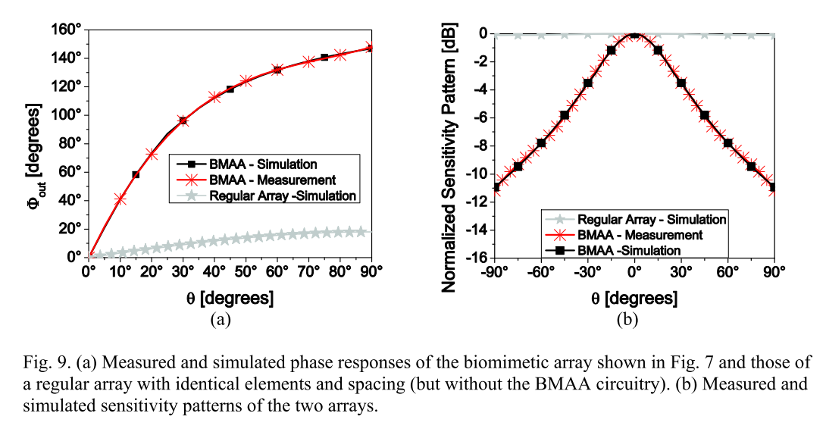
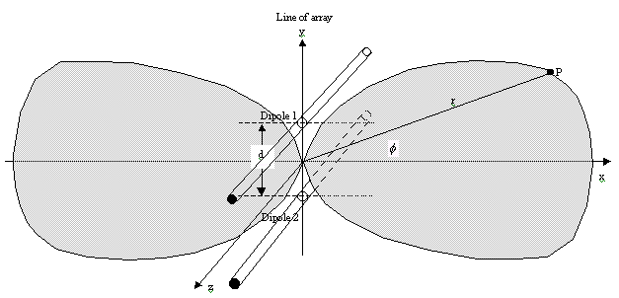
Technical Approach:
Antenna geometry

Slide 14
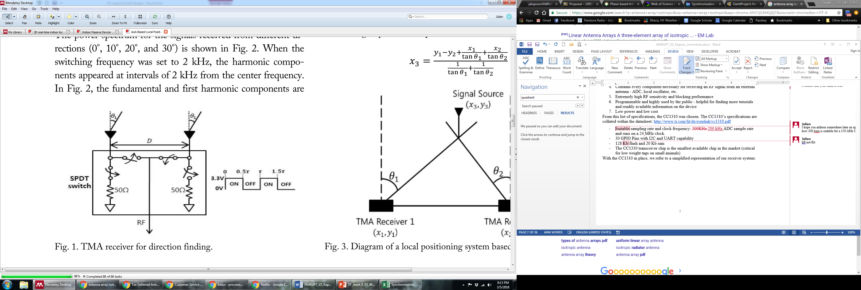
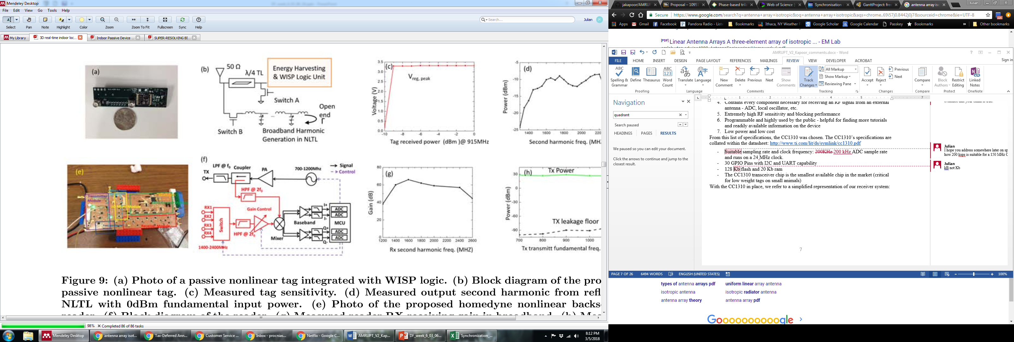
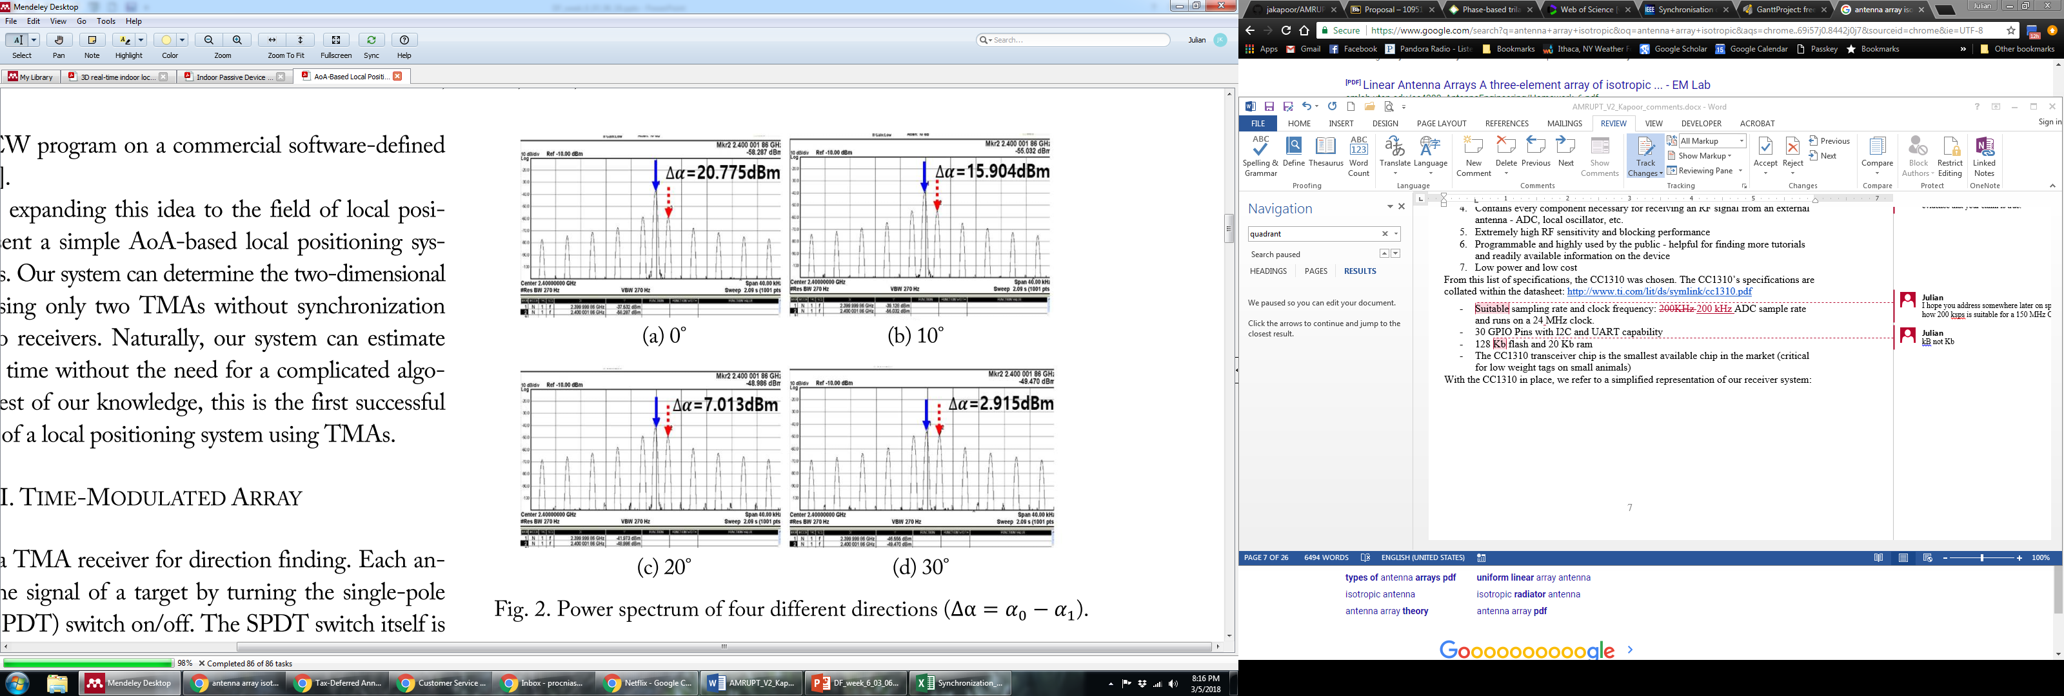
Technical Approach: RF switch

Slide 15
Technical Approach: Raspberry Pi
What technical analysis led to the choice to use UART?!
E.g. If studies 1-7 (or simulation X, Y) indicate required sampling rate > 500 ksps
 | UART | SPI | I2C
Speed | 100 ksps | 1 Msps | 55 ksps
# I/O ports | 2 | 5 | 2

Slide 16
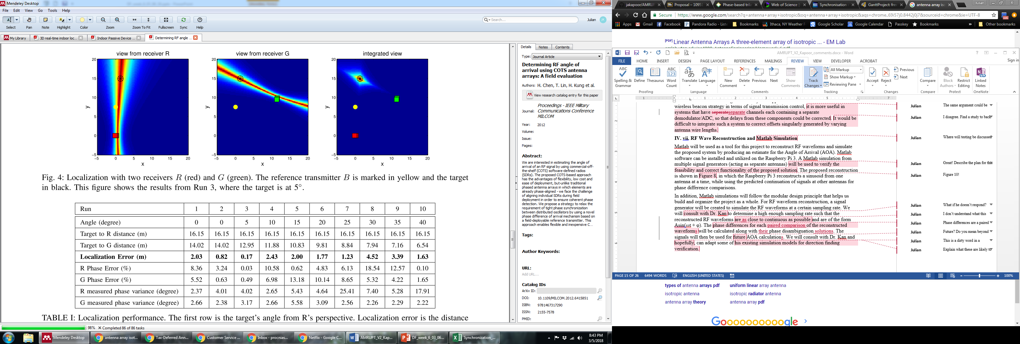
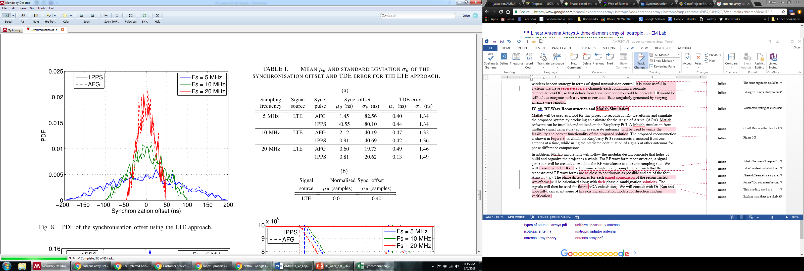
Technical Approach: Channel equalization
None versus Beacon versus LFM equalization
Support your assertions with data from other studies!
Beacon-synchronized
Internally-synchronized
vs.

Slide 17
Technical Approach: RF wave reconstruction and Under-sampling
Is 200 ksps (CC1310) adequate?
How will we know (and at what stage in the design)?
Other systems use sampling rates of > 20 Msps. Why? How?
What happens with undersampling as our Tx RF signal becomes less stable?

Slide 18
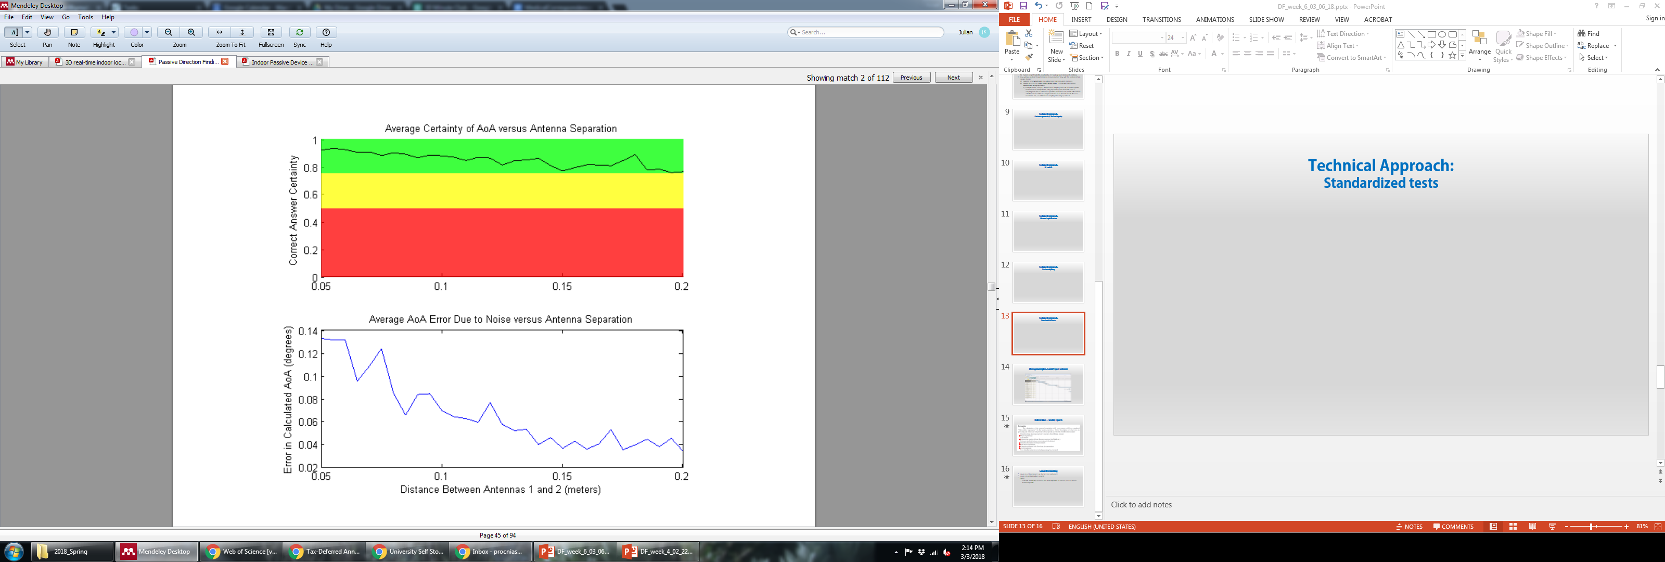
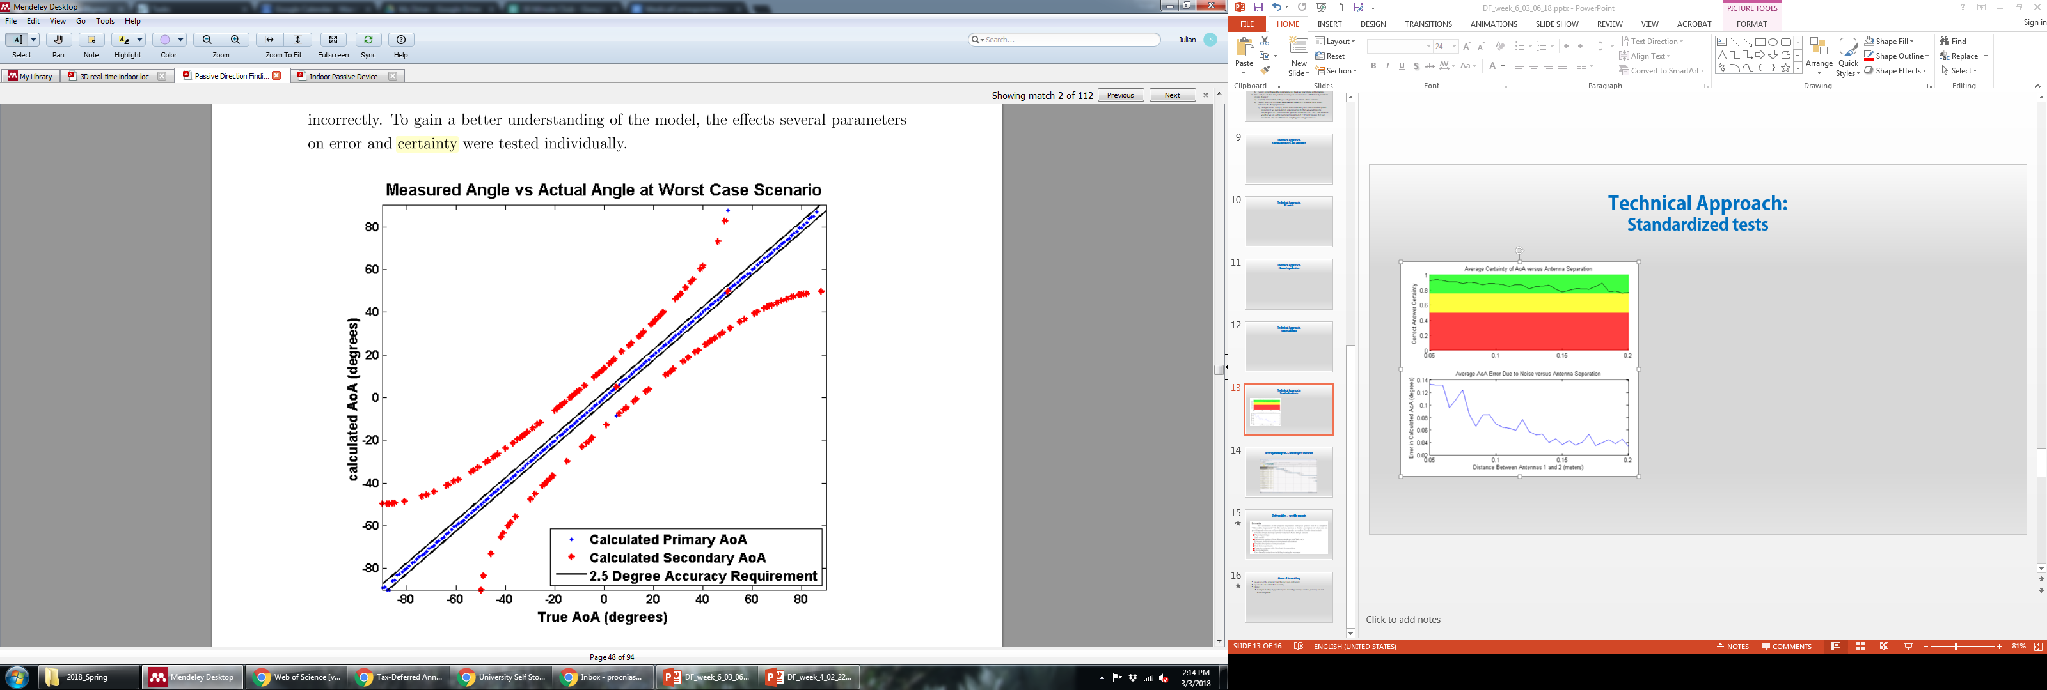
Technical Approach: Standardized tests
Average certainty that the best AOA estimate is the true AOA
Average error of AOA
vs.
Range, noise, antenna separation, sample rate, carrier frequency, etc.

Slide 19
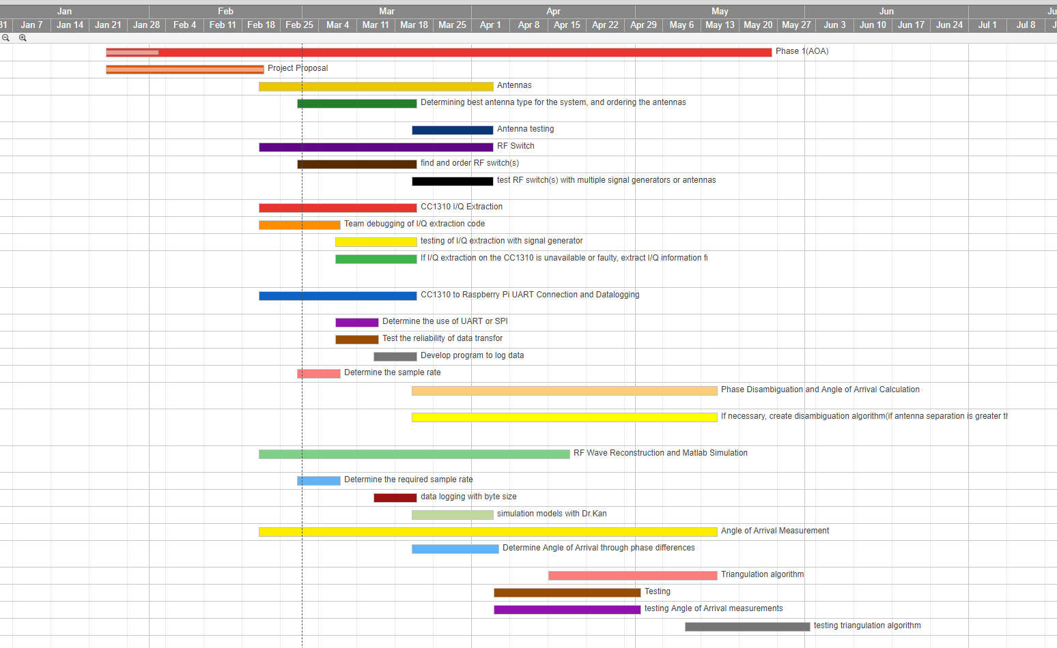
Management plan: GanttProject software

Slide 20
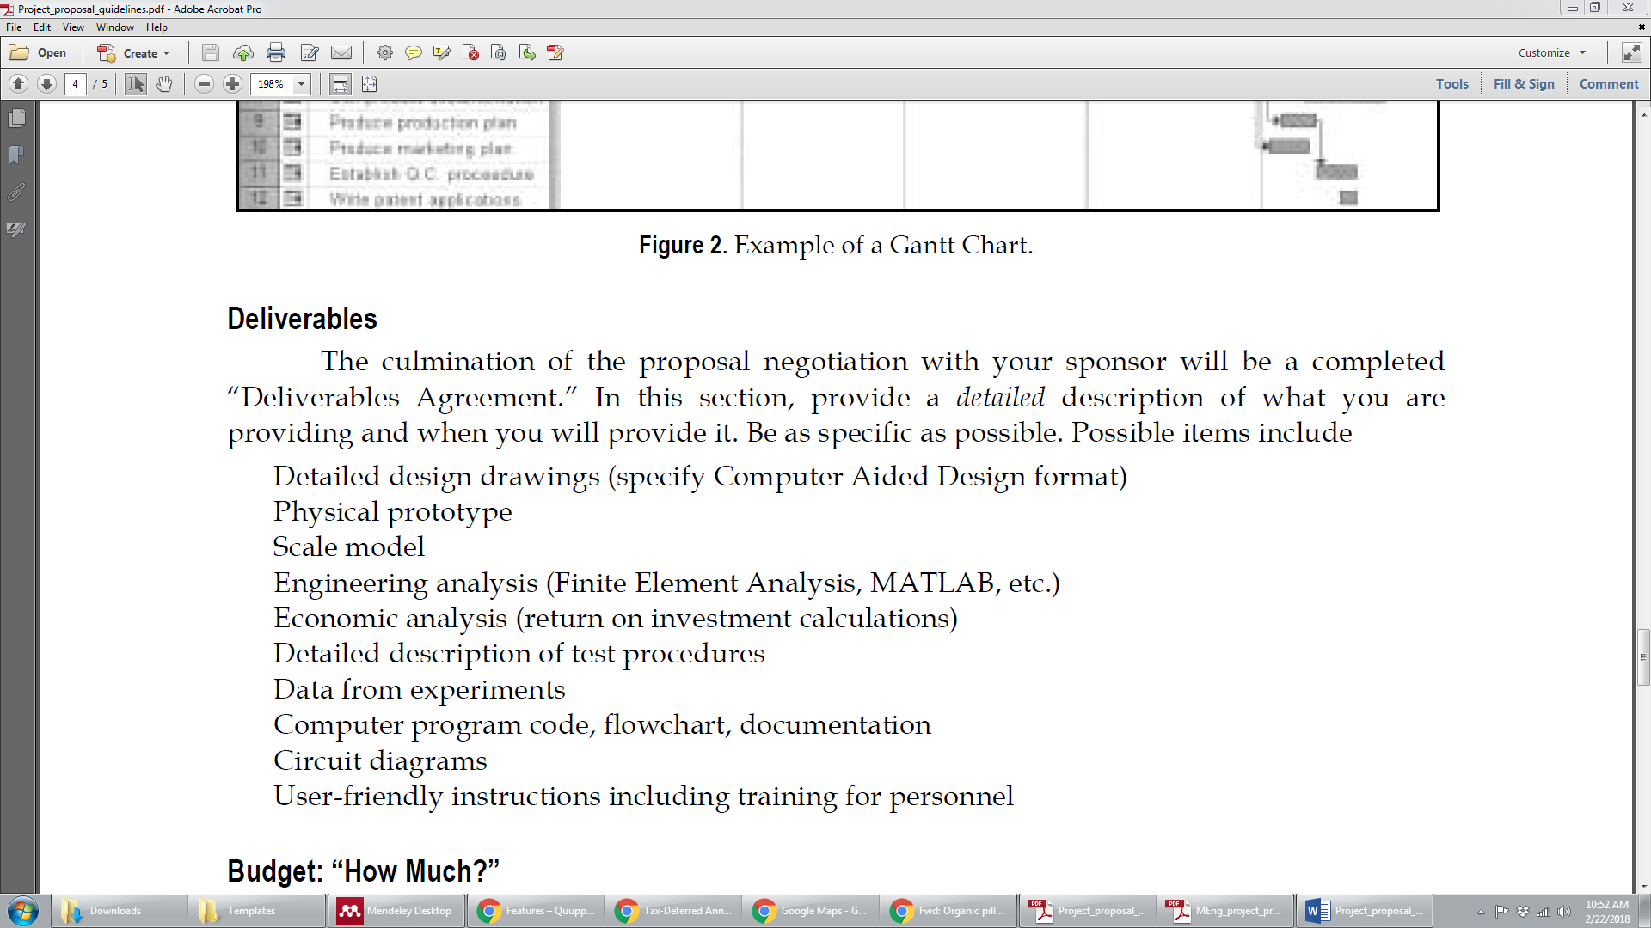
Deliverables $≠$ weekly reports

Slide 21
General formatting
Figures must be referred to in the text (not orphaned)!
Figures should be labelled correctly
Clarity!
Example: Ambiguity (problem) and disambiguation (a solution process) are not interchangeable

Slide 22
Where to go from here?
Create list of “deliverables” including
Specific system tests
Hardware prototypes
Simulation results
Review literature for answers to specific design considerations and choices
Literature review
Technical approach
Dr. Kan and his students have researched existing designs, written about them (see their literature reviews), and improved upon them. Go to him/them with specific questions about design considerations (E.g. What RF switch to use? Is an SDR a better choice than the CC1310? How fast must we sample? Etc.)

